Slide 2




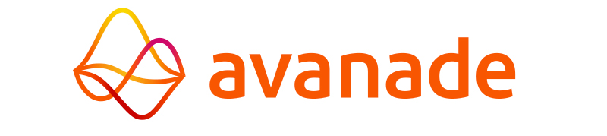
Serverless logic with Azure functions
Welcome
Tarun Arora
Head of DevOps & Software Engineering
Avanade UK&I
Microsoft MVP – Azure Dev Tools
@arora_tarun
Marcel Lupo
DevOps Manager - Software Engineering
Avanade UK&I
Microsoft MVP – Azure Dev Tools
@Pwd9000

Slide 3
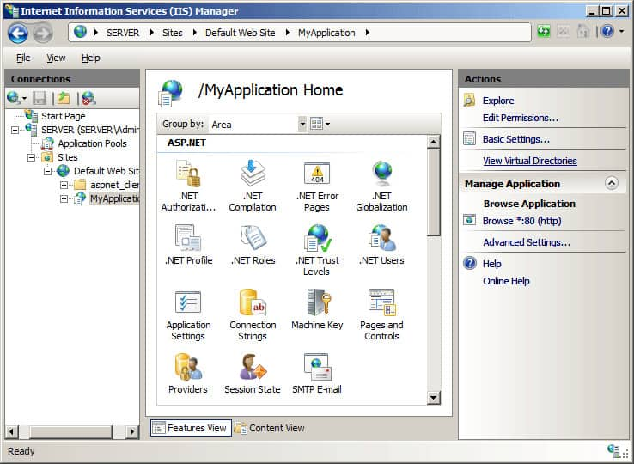

Web Apps in 2010 - Remember this?
“
Internet Information Services (IIS) for Windows® Server is a flexible, secure and manageable Web server for hosting anything on the Web
“
Vertical scaling
Load Balancer
Horizontal scaling

Slide 4
Serverless Computing
“
… cloud computing execution model in which the cloud provider allocates fully managed machine resources on demand.
--Azure Serverless Functions
“

Slide 5

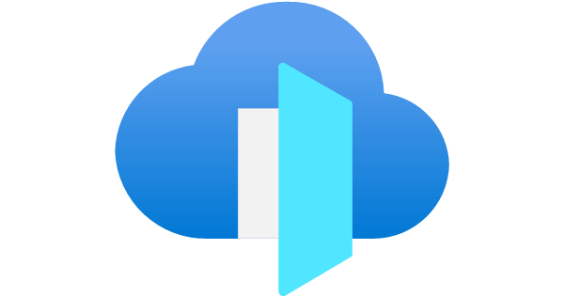



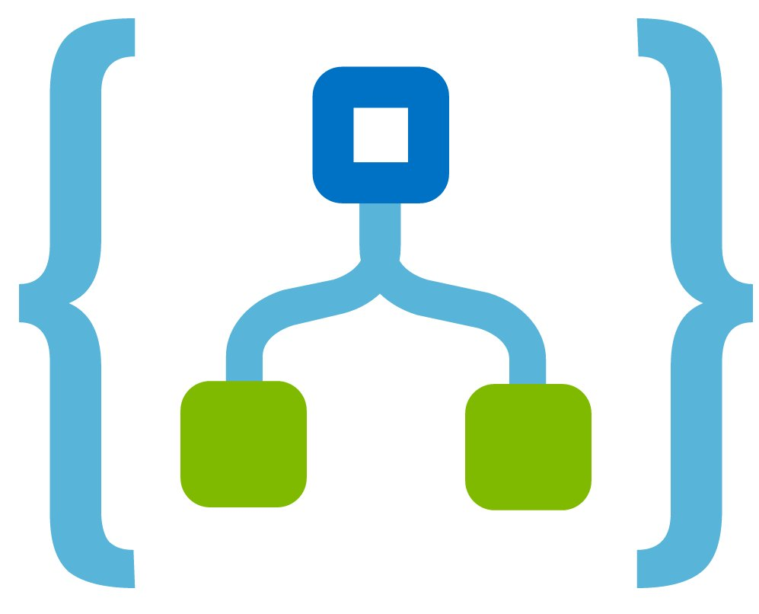









Serverless Architecture
Event driven scaling
Manage applications not Servers
Faster time to value
DevOps led Intelligent Engineering
Pay for use, consumption models
Increase developer productivity

Slide 6



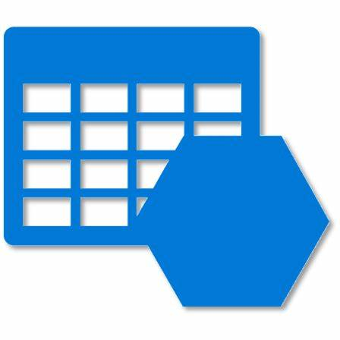


Demo Storyline…
Backplane
Static Website

Slide 7
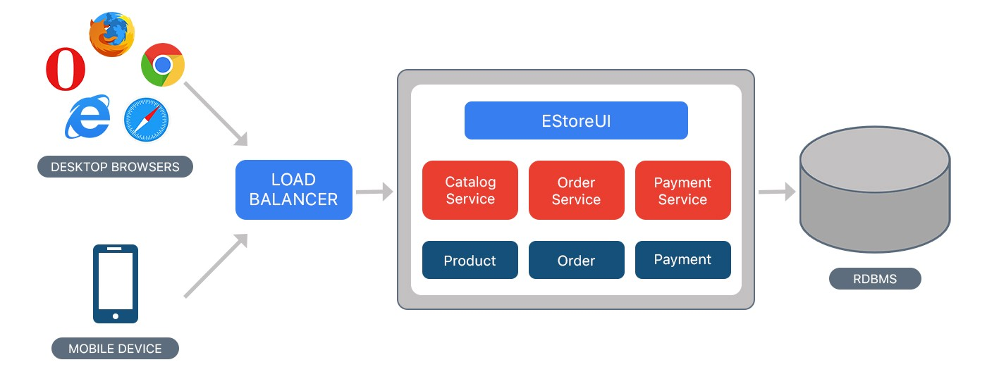
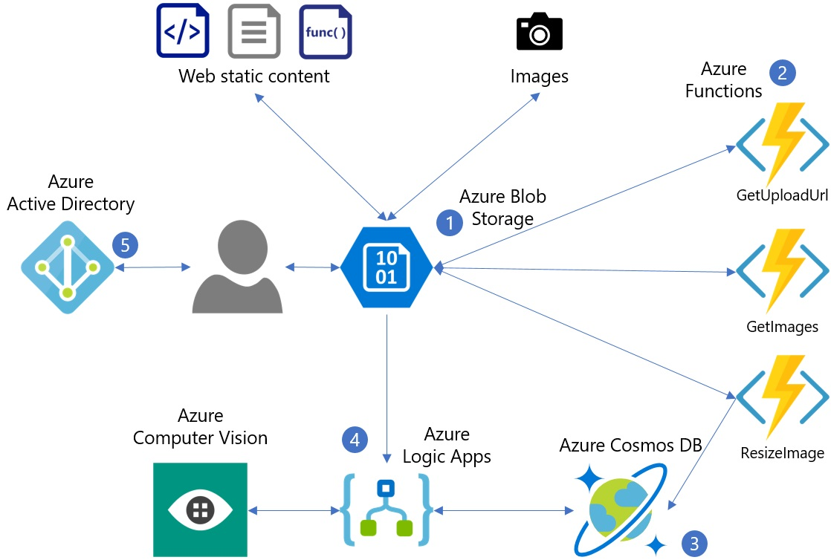
Summary
FROM
Azure Serverless | Microsoft Azure
“Go serverless—build apps faster without managing infrastructure”
Responsive
TO
Elastic
Resilient
Message driven

